Slide 1
Kafka Streams

Slide 2
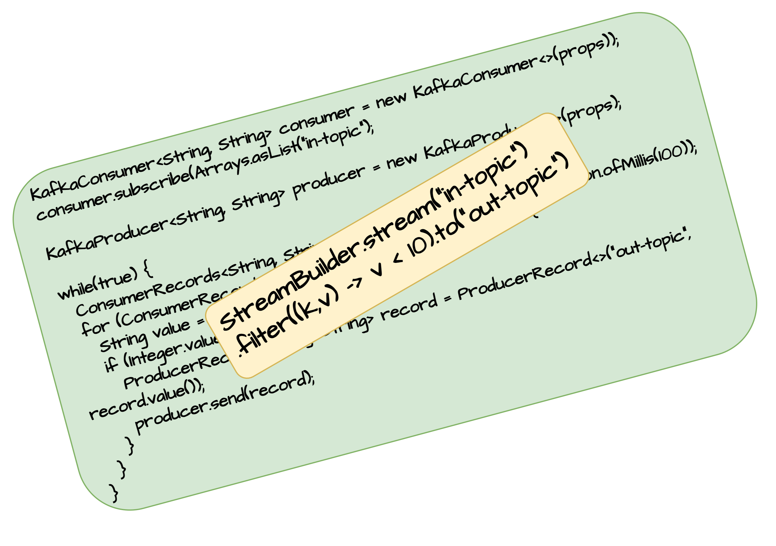
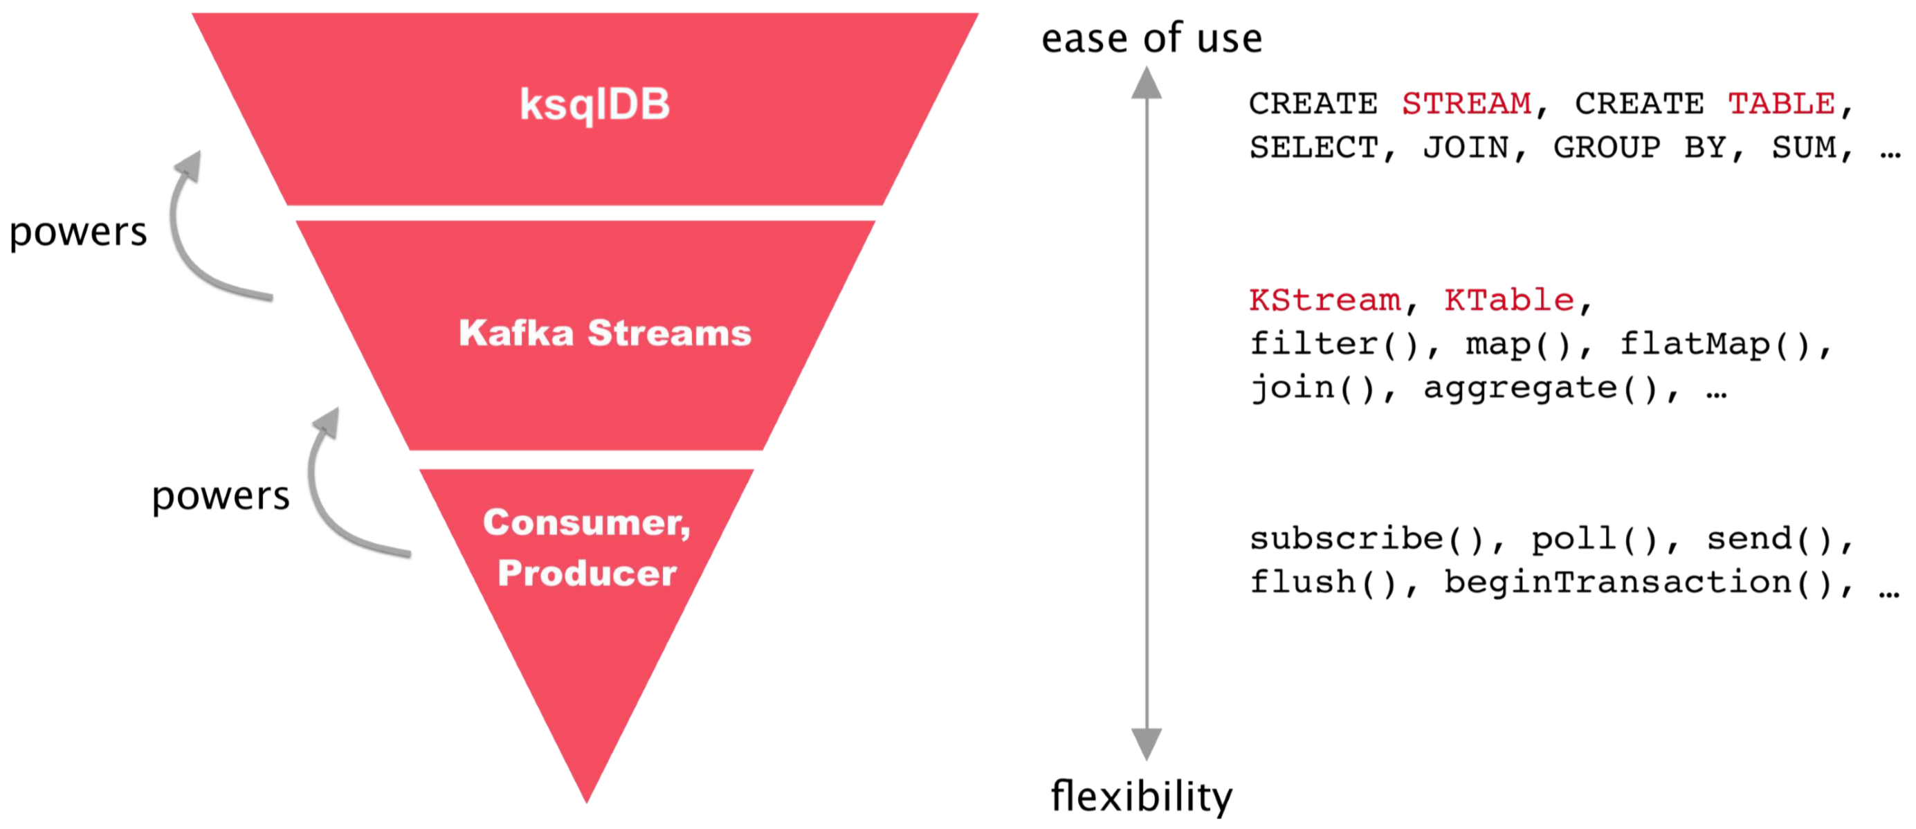
Why Kafka Streams
The Kafka Streams API is a client-side library that sits alongside the existing Kafka client APIs. The Consumer and Producer APIs read and write to Kafka topics. Kafka Streams, which use the Consumer and Producer APIs under the hood, provides the ability to stream messages in real-time from a topic, processing and reacting to the data, before writing the transformed and enriched data to other topics.
Kafka streams provide a declarative approach to stream processing and provides a fluent domain specific language (DSL) that allows users to make a description of what needs to be done. Under the hood the framework takes take of all the operations needed to achieve the result. This is opposed to an imperative approach you would use if you were to build the same logic using vanilla Kafka consumers & producers.
Using DSL makes the code more scalable and robust and heavily reduces the number of code-lines

Slide 3
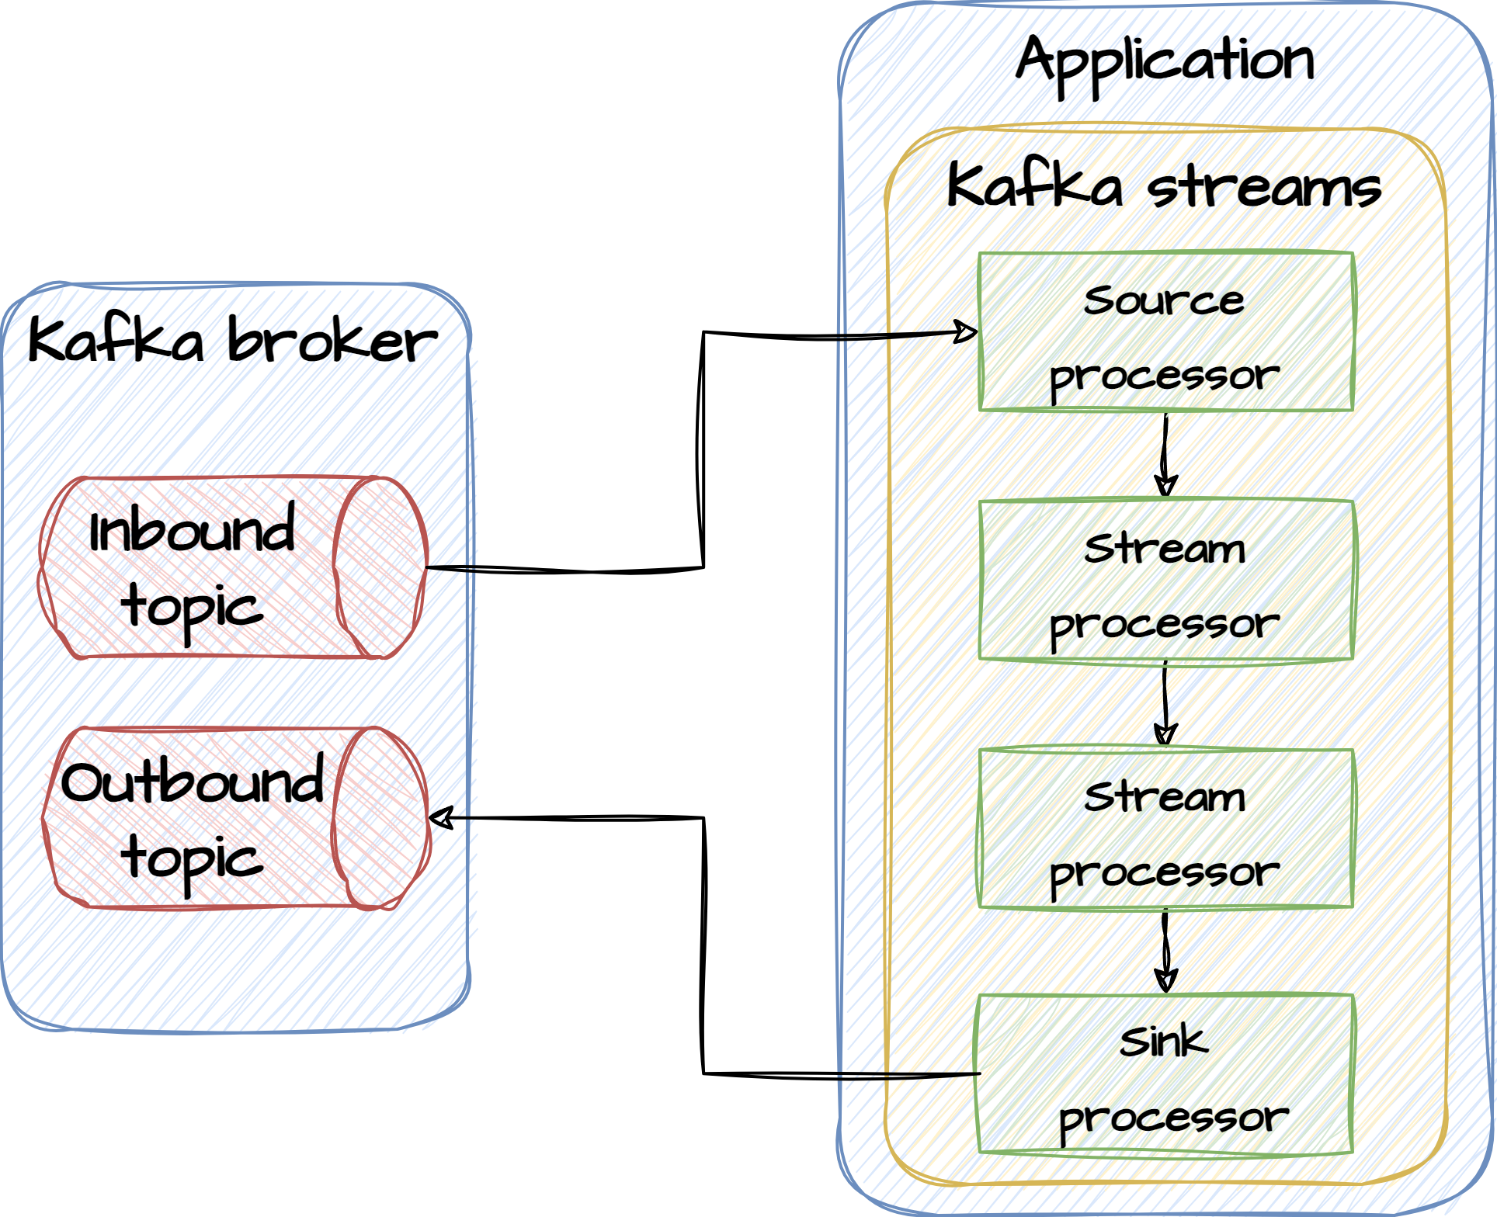
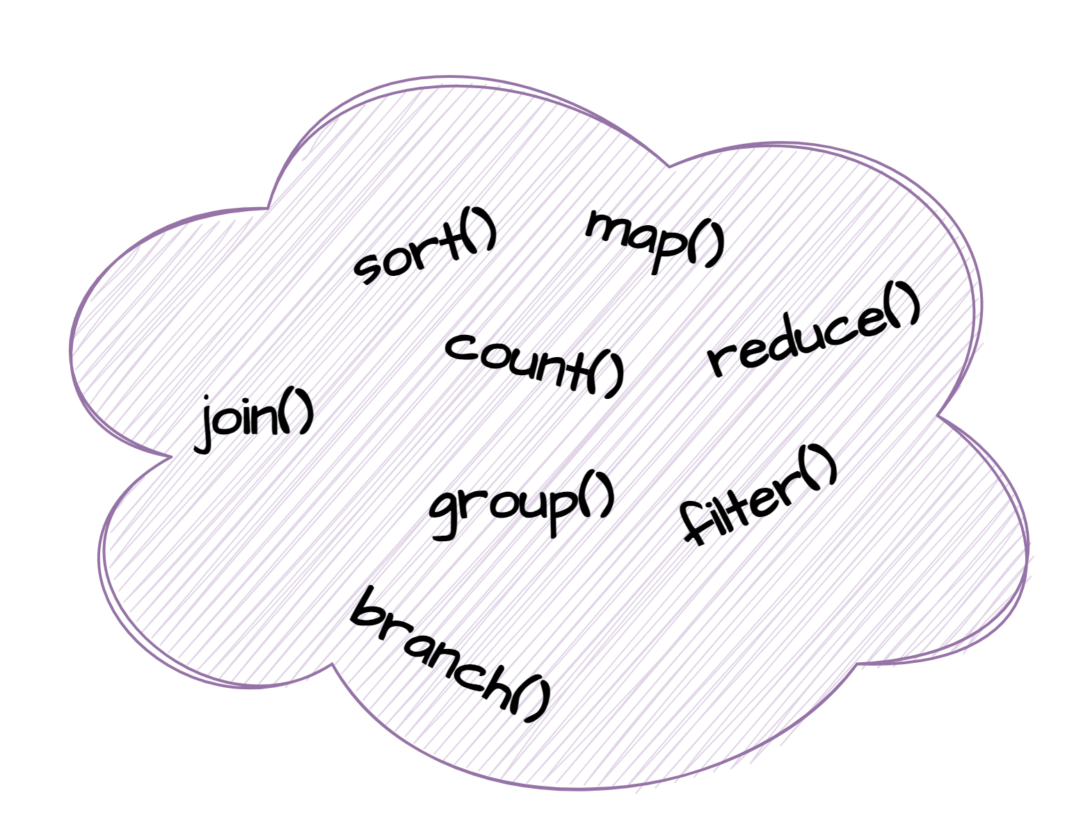
Why Kafka Streams
Kafka Streams is an ETL framework (Extract-Transform-Load) that is based on the concept of processors. Processors are small building blocks that can be setup in a ‘unix pipe’-like fashion. Output from one processor serves as input to the next. Processors can do filtering, projections and aggregations. This allows for Single Message Transform or stateful processing where the result depends on the history of previous events. Stateful allows us to join data from other streams or tables, group data in time windows, and aggregate related events, using a backing store to maintain state.
Each message is passed through a processor topology serially, such that each subsequent message is not processed until the previous one has completed. The topology can be divided into sub-topologies, and these sub-topologies will process messages in parallel with other sub-topologies.
Topology

Slide 4
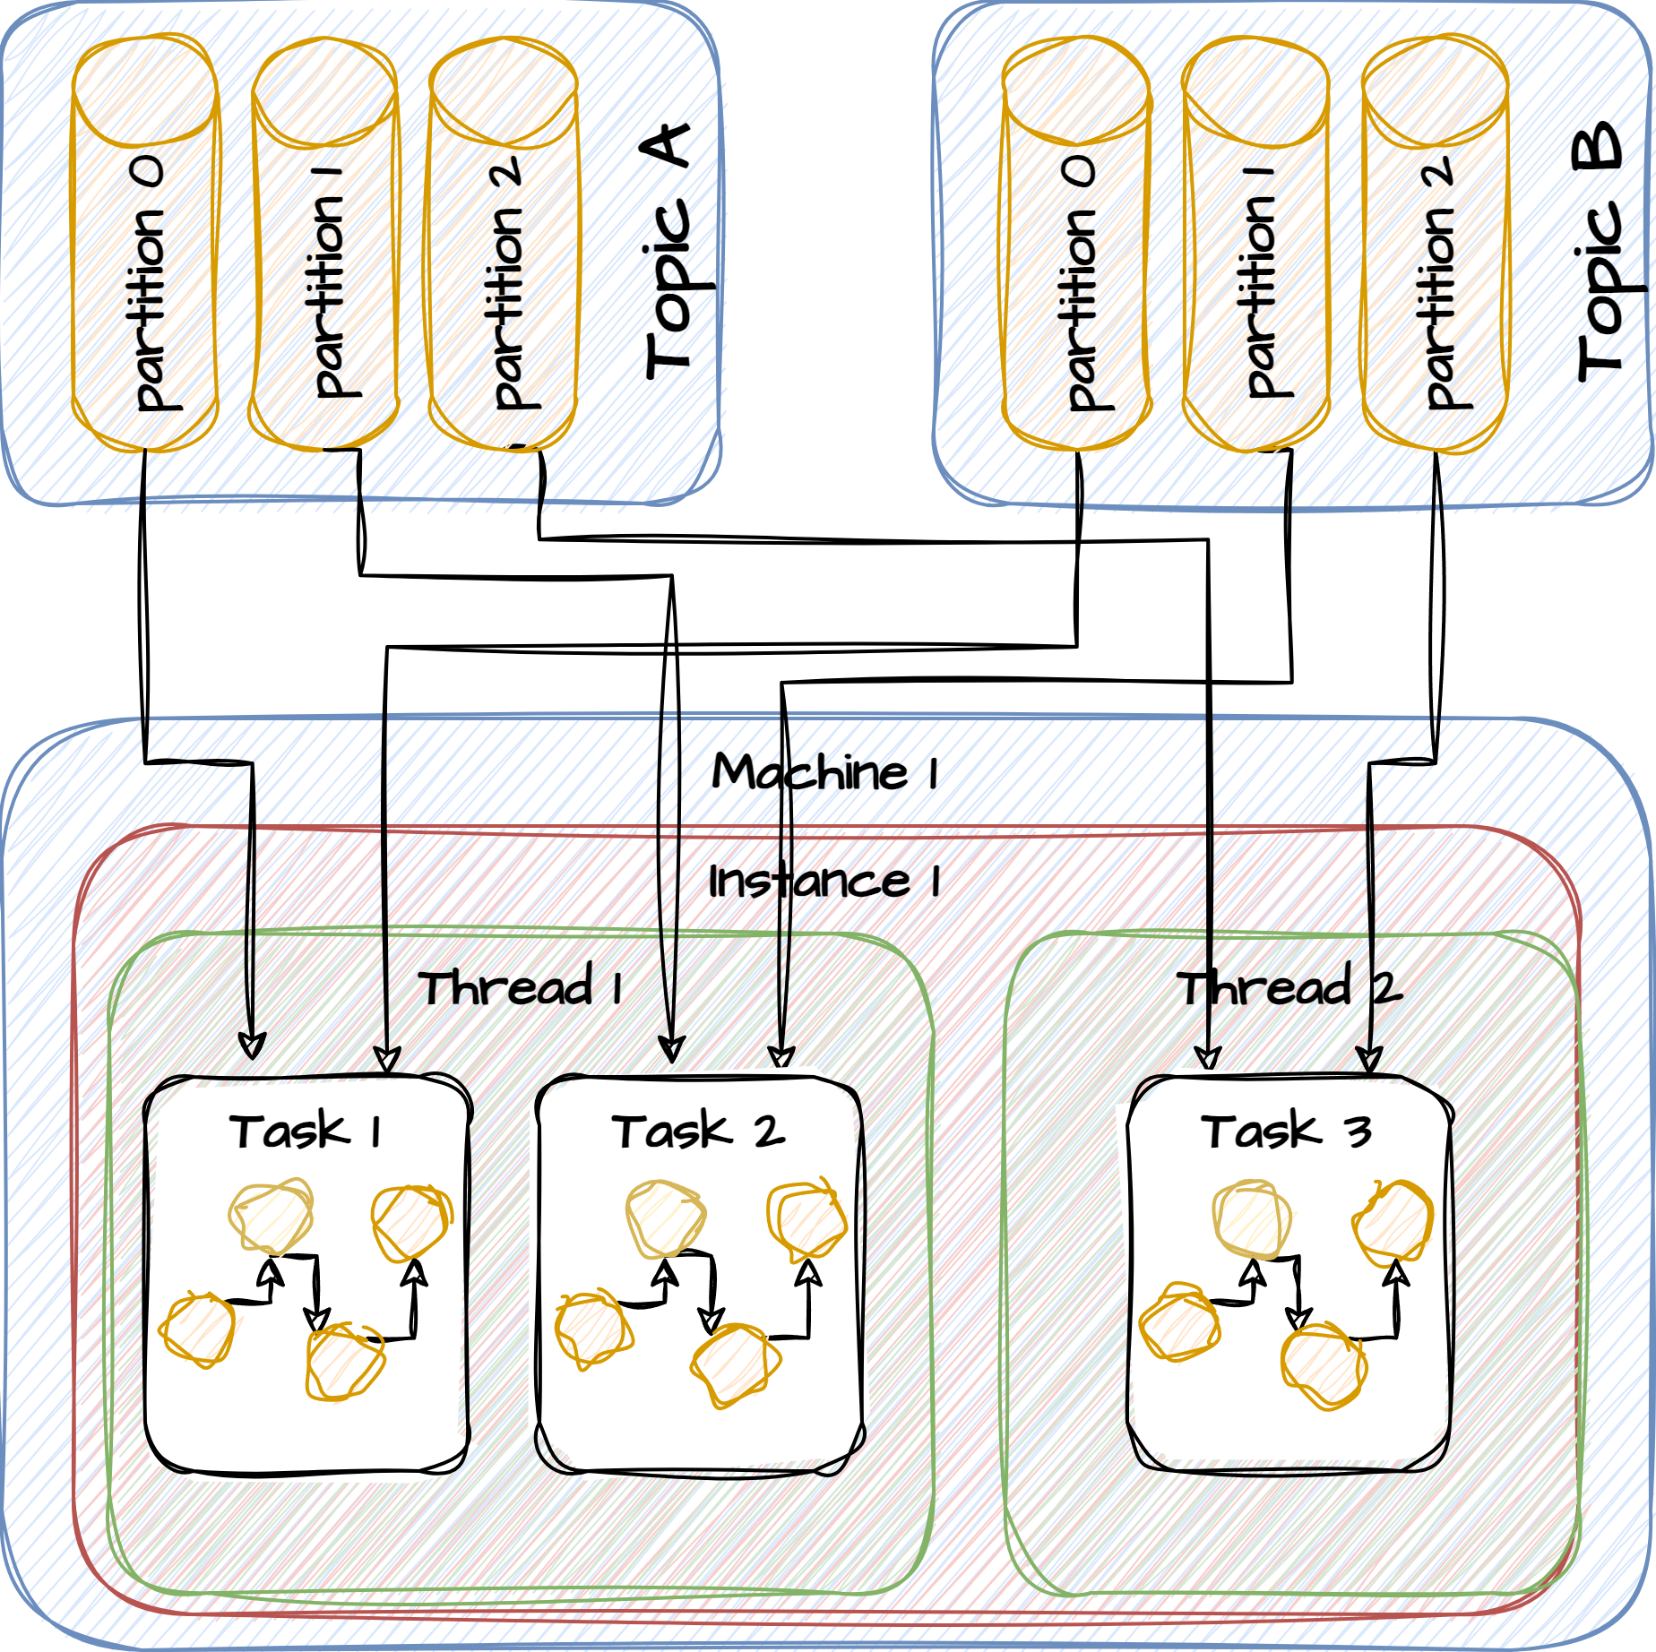
Architecture
One task pr partition

Slide 5
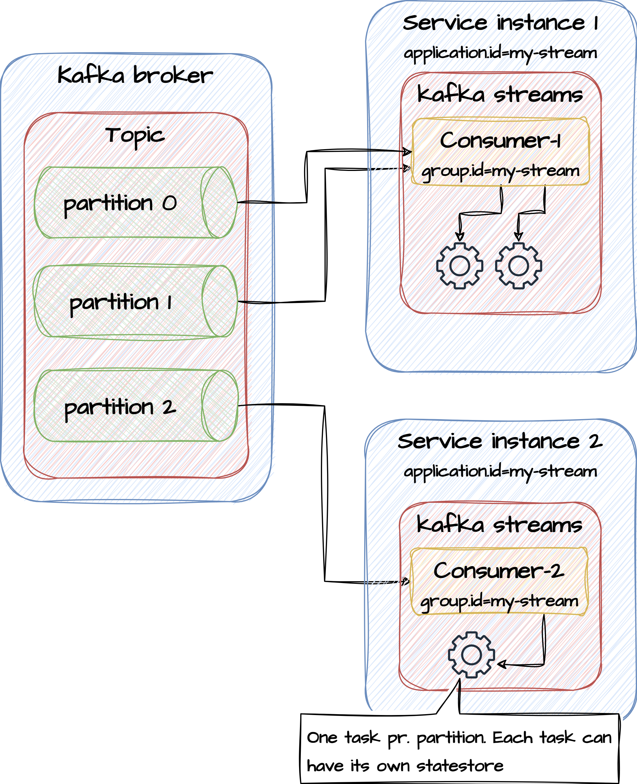
Tasks and threads
Kafka Streams assigns each source topic partition to a task, and each task has its own copy of the topology.
A topic with 10 partitions will have 10 tasks. Threads, which are isolated and thread-safe, then execute the tasks. The creation of threads is managed by Kafka Streams so is not a developer concern. The number of threads is configurable, based on the num.streams.threads setting. This cannot exceed the task count. If num.streams.threads was configured to be 5 threads, then with 10 partitions each thread would execute 2 tasks. The higher the thread count the better the utilisation that can be made of the available CPU resources.

Slide 6
Topology
A Kafka Streams topology is a directed acyclic graph (DAG) that represents a Kafka Streams application's processing logic. It defines how data flows within your application, including the input sources, the transformations, and the output sinks. In other words, it specifies the sequence of processing steps and operations that your Kafka Streams application performs on data as it flows through the system.
Source Nodes: These nodes represent the starting point of your processing pipeline. Source nodes read data from Kafka topics and convert them into Kafka Streams, which are represented as KStream or KTable objects.
Processor Nodes: These nodes represent the intermediate processing steps in your application. Processors apply various transformations to the input data, such as filtering, mapping, aggregating, and joining. Each processor typically takes input from one or more parent nodes (source nodes or other processors) and produces output data that can be consumed by downstream processors.
Sink Nodes: Sink nodes represent the endpoint of your processing pipeline. They typically write the processed data to Kafka topics, external databases, or other output destinations.
State Stores: State stores are used for maintaining and accessing stateful data in your Kafka Streams application. They allow you to store and retrieve data for operations like windowed aggregations or maintaining changelogs.

Slide 7
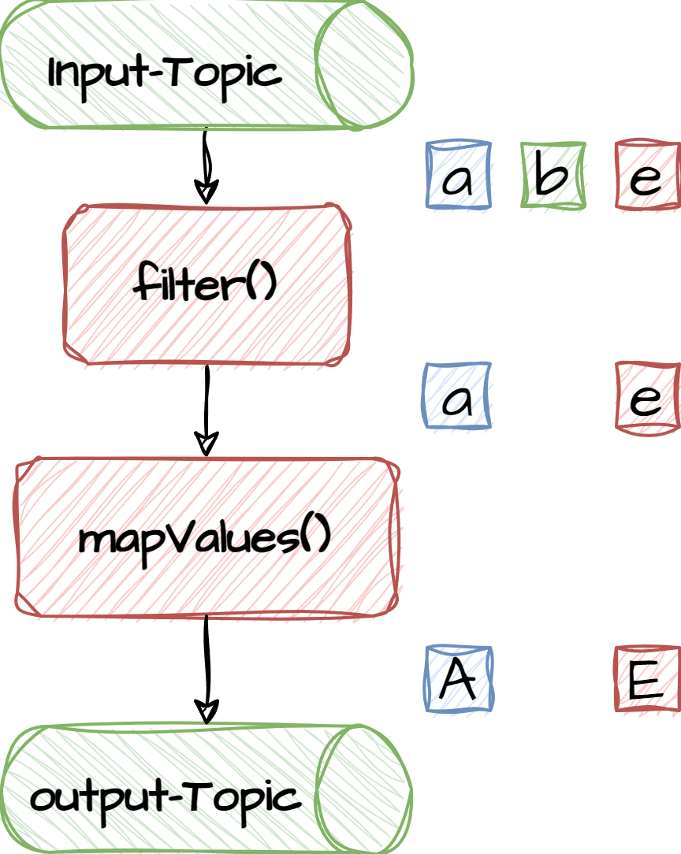
Define topology with DSL
Properties props = ...
// Define topology - begin
StreamsBuilder builder = new StreamsBuilder();
builder.stream(“inputTopic”);
.filter((k,v) -> v.color() != green)
.mapValues(v -> v.label().toUpperCase())
.to(“outputTopic”, Produced.with(..., ...));
Topology topology = builder.build();
// Define topology - end
// Build and start stream
KafkaStreams streams = new KafkaStreams(topology, props);
streams.start();
Source processor
Filter processor
Map processor
Sink processor

Slide 8
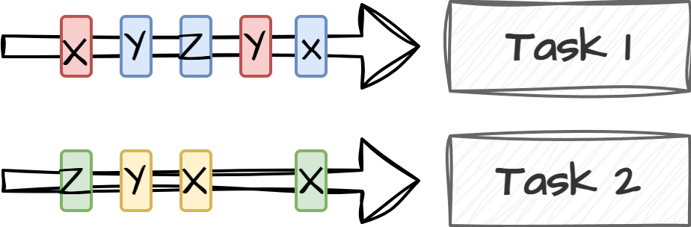
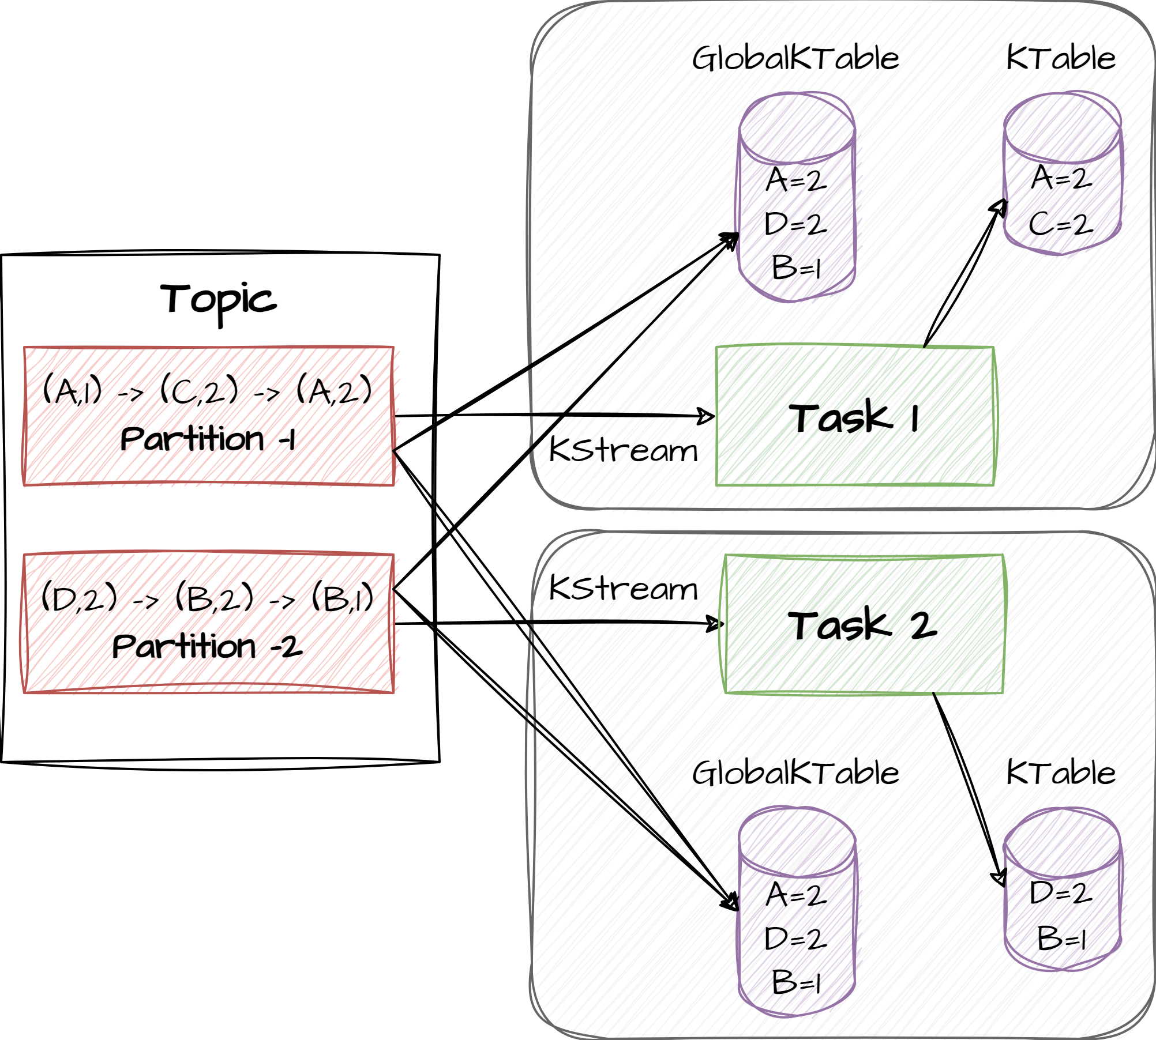
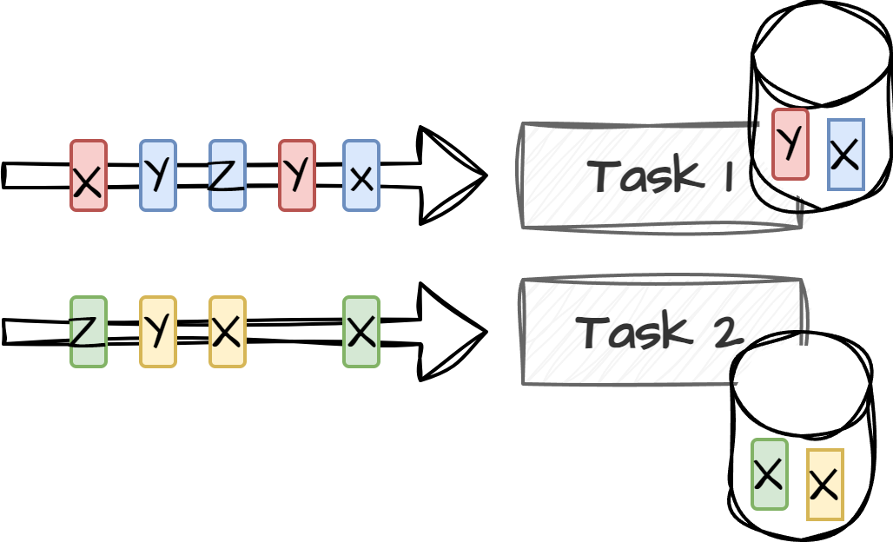
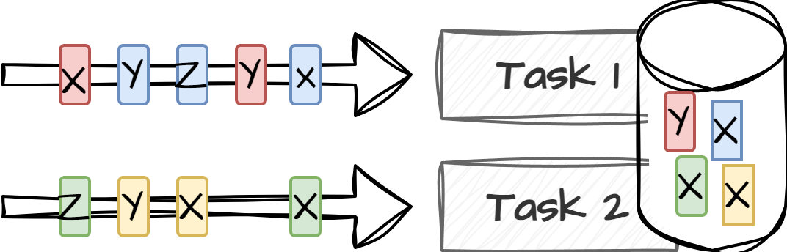
Creating source streams
Kstream is an abstraction of a continuous stream of events that can be build from a kafka topic.
KStream<String, String> myKStream = builder.stream(“inputTopic”);
Ktable is a stateful table like structure that holds the latest value for each key in the processed partition
KTable<String, String> myKTable = builder.table(“inputTopic”);
GlobalKtable is a stateful table like structure that holds the latest value for each key in the processed topic
GlobalKTable<String, String> myGlobalKTable = builder.globalTable(inputTopic);

Slide 9
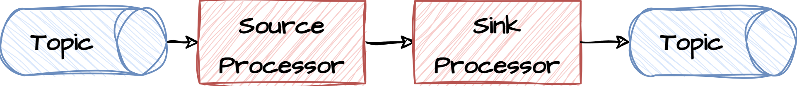
Exercise
Create simple stream
Create an input topic named inputTopic and an output topic named outputTopic
Write a topology that read messages from input and write them to output
Start the stream application
Start a producer that produces messages to the input topic like this:
Open PowerShell window and navigate to <project>/docker folder
Type .\kafka-producer-perf-test.bat --topic inputTopic --num-records 10000 --throughput 1 --record-size 5
Open a new PowerShell window and navigate to <project>/docker folder:
Type .\kafka-consumer.bat --topic outputTopic --from-beginning --property print.partition=true --property print.offset=true
Verify that messages are being sent to the output topic
8.1

Slide 10
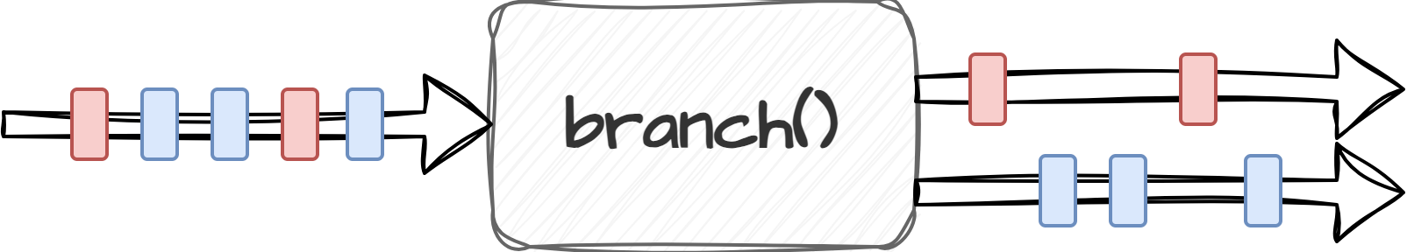
Stateless processors
branch() splits the stream into one or more streams based on predicates
KStream<String, String> stream = ...;
Map<String, KStream<String, String>> branches =
stream.split(Named.as("Branch-"))
.branch((key, value) -> key.startsWith("A"), /* first predicate */ Branched.as("A"))
.branch((key, value) -> key.startsWith("B"), /* second predicate */ Branched.as("B"))
.defaultBranch(Branched.as("C"))
);
Or:
KStream<K, V> stream = ...;
stream.filter((key, value) -> key.startsWith("A")).to(“Branch-A");
stream.filter((key, value) -> key.startsWith(“B")).to(“Branch-B");
stream.filter((key, value) -> !key.startsWith("A") && !key.startsWith(“B")).to(“Branch-C");

Slide 11
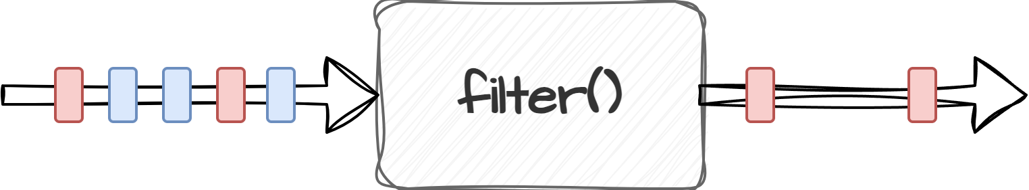
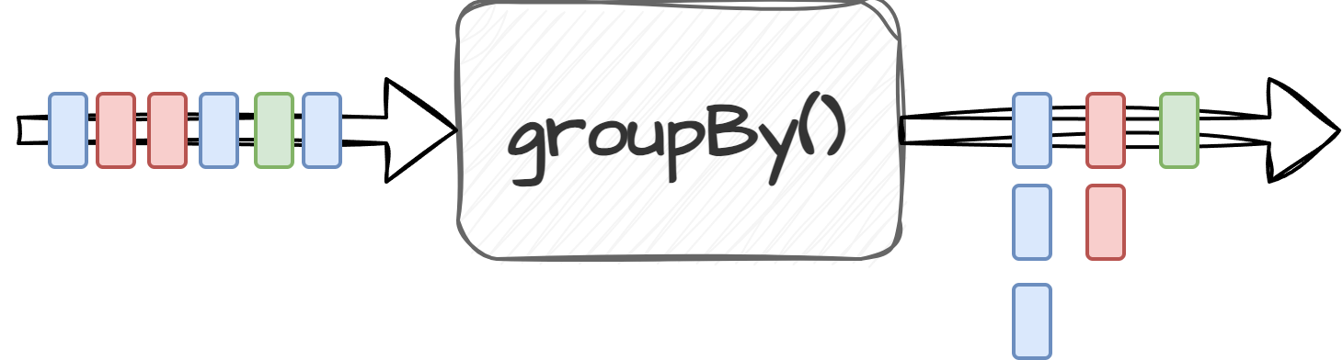
Stateless processors
filter() removes records from a stream based on a predicates
KStream<K, V> stream = ...;
stream.filter((key, value) -> key.startsWith("A"));
groupBy() groups records by a new key
KStream<byte[], String> stream = ...;
KGroupedStream<String, String> groupedStream = stream.groupBy((key, value) -> key, Grouped.with(Serdes.String(), Serdes.String()));

Slide 12
Exercise
Create filtered stream
Create an input topic named inputTopic and an output topic named outputTopic
Write a topology that read messages from input topic, filter off all messages not containing the letter ‘a’ or ‘A’ (uppercase) and write them to output topic
Start the stream application
Start a producer that produces messages to the input topic like this:
Open powershell window and navigate to <project>/docker folder
Type .\kafka-producer-perf-test.bat --topic inputTopic --num-records 10000 --throughput 1 --record-size 5
Open a new PowerShell window and navigate to <project>/docker folder:
Type .\kafka-consumer.bat --topic outputTopic --from-beginning --property print.partition=true --property print.offset=true
Verify that only messages containing the letter ‘a’ are being sent to the output topic
8.2

Slide 13
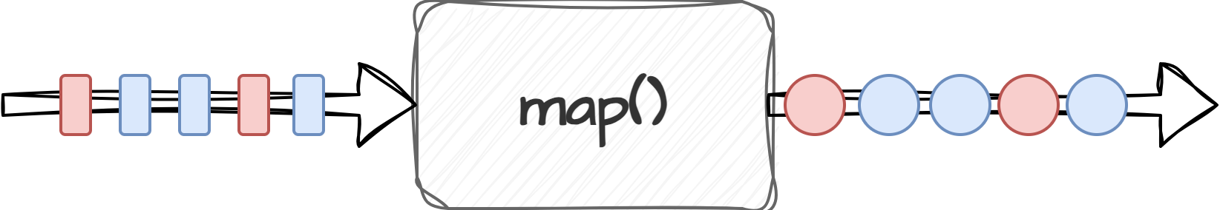
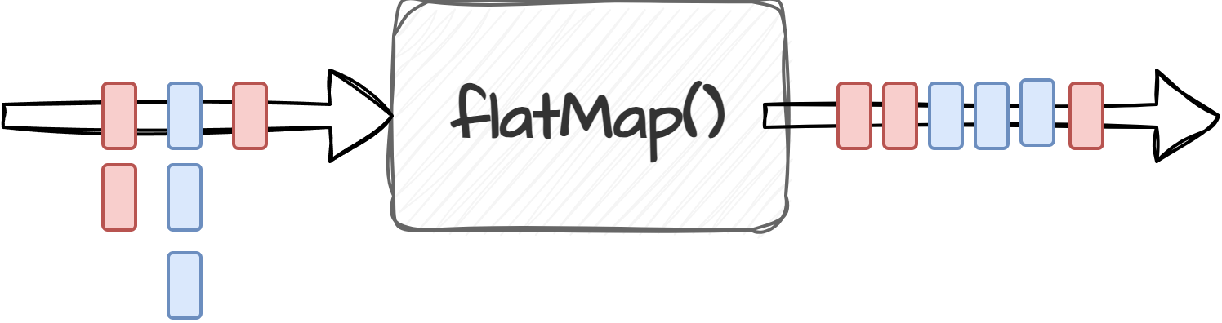
Stateless processors
map() / mapValues() takes one record, transforms it and produces a new record
KStream<K, V> stream = ...;
KStream<String, String> mappedStream = input.mapValues(value -> value.toUpperCase());
flatMap() takes one record and produces zero, one or more records
KStream<K, V> stream = ...;
stream.flatMapValues(value -> Arrays.asList(value.toLowerCase().split(" ")));

Slide 14
Exercise
Create mapped stream
Create an input topic named inputTopic and an output topic named outputTopic
Write a topology that read messages from input topic, replace all ‘a’ and ‘A’ characters with an hyphen(-) and write them to output topic
Start the stream application
Start a producer that produces messages to the input topic like this:
Open powershell window and navigate to <project>/docker folder
Type .\kafka-producer-perf-test.bat --topic inputTopic --num-records 10000 --throughput 1 --record-size 5
Open a new powershell window and navigate to <project>/docker folder:
Type .\kafka-consumer.bat --topic outputTopic --from-beginning --property print.partition=true --property print.offset=true
Verify that only messages have the letter ‘a’ or ‘A’ replaced with ‘-’
8.3

Slide 15
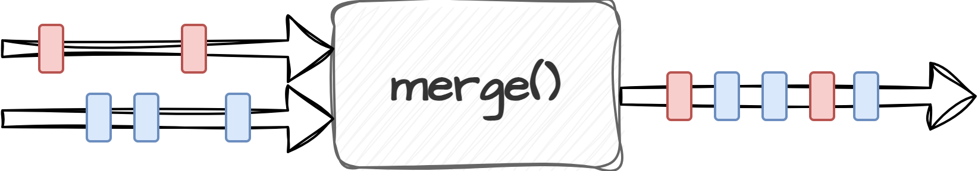
Stateless processors
merge() merges records from two streams into a new stream
KStream<K, V> streamA = ...;
KStream<K, V> streamB = ...;
KStream<String, String> mergedStream = streamA.merge(streamB);

Slide 16
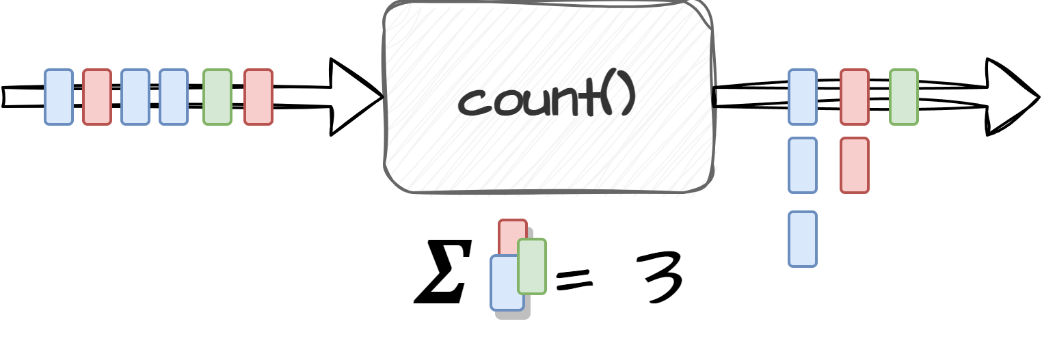
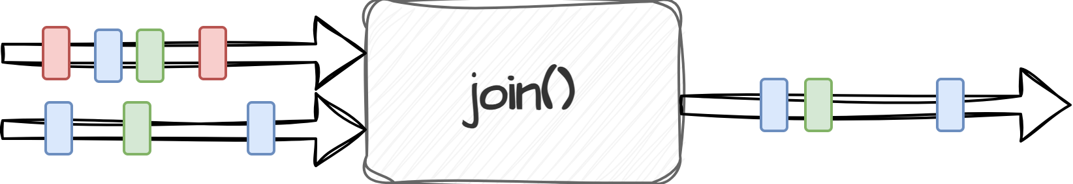
Stateful processors
count() counts the number of records by the grouped key
KStream<K, V> stream = ...;
stream.groupBy((key, value) -> value)
.count()
join() merges records from two streams into a new stream. Co-partitioning needs to be in place
KStream<K, V> streamA = ...;
KStream<K, V> streamB = ...;
KStream<String, String> joinedStream =
streamA.join(streamB, (valueA, valueB) -> valueA + "-" + valueB,
JoinWindows.of(10000),
Materialized.with(Serdes.String(), Serdes.String();

Slide 17
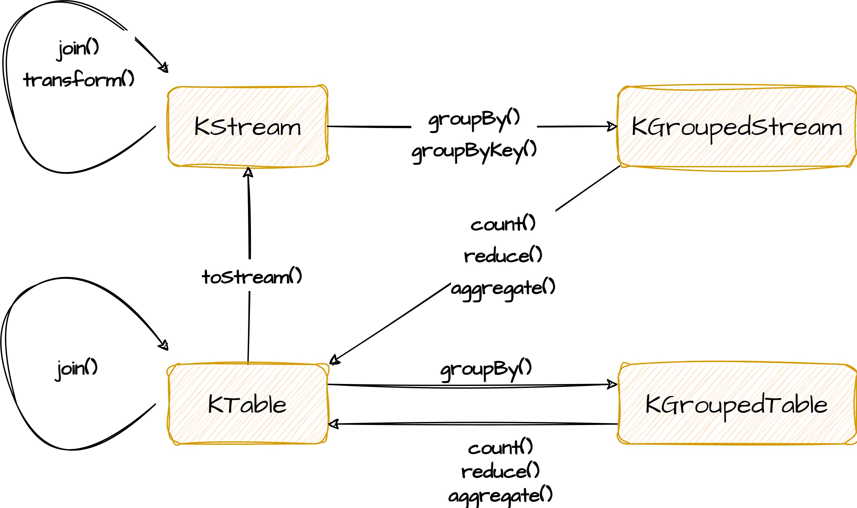
Transformation relationships

Slide 18
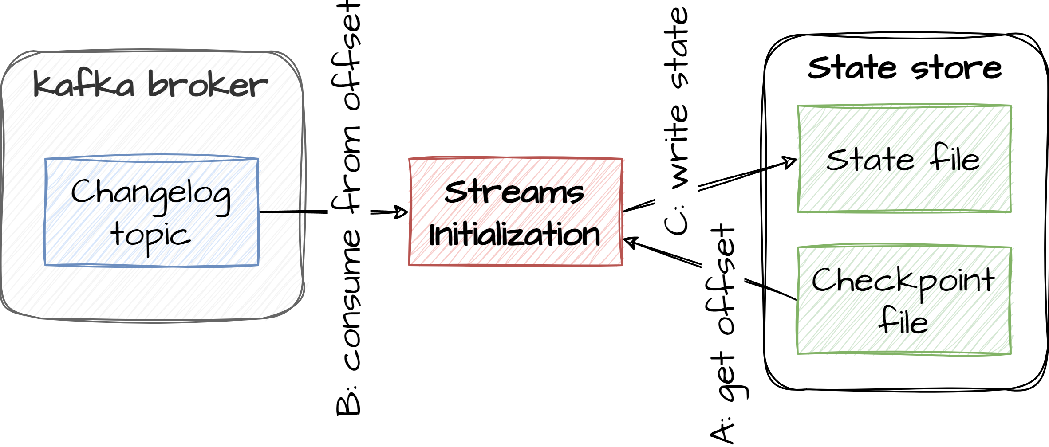
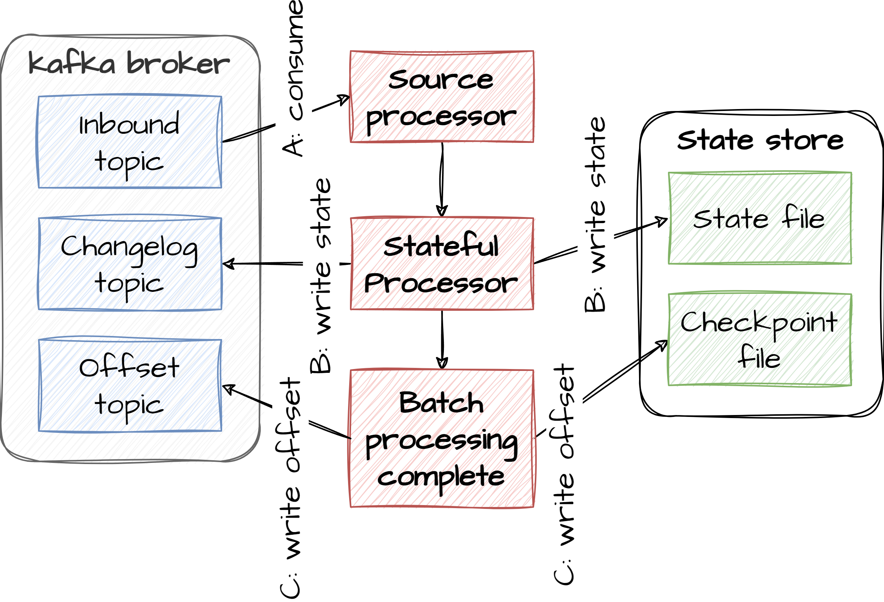
State stores
When processing infinite streams, we cannot do join or aggregation processing without maintaining state of precious records in the stream. In Kafka streams this is handled through state stores. Each task has its own state store. A state store is a local cache that is backed by a lightweight database called Rocks DB. Alternative implementations can be chosen such as in-mem, Redis, etc. Because tasks can be ephemeral or temporarily unavailable (crashes, network issues etc), Kafka maintains a backup of the state store in a compacted Kafka changelog topic. This allows new tasks to take over and proceed from where old tasks left without having to replay the entire event stream. New tasks will simply rebuild its state store from the change-log topic during initialization
Backup of state store
Local state

Slide 19
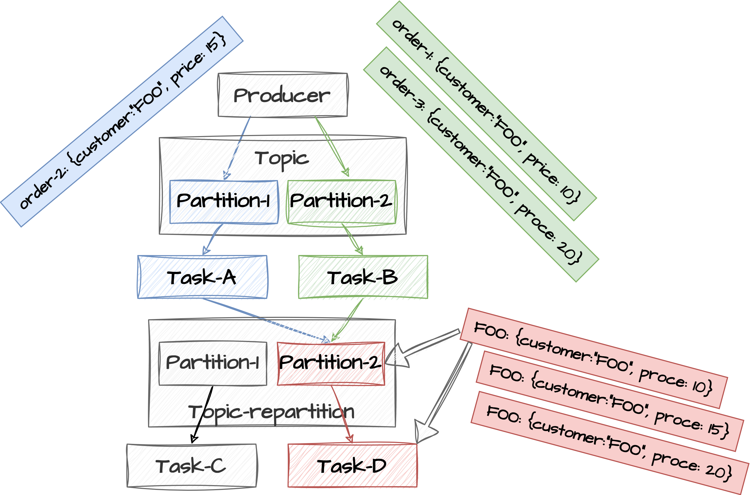
Re-partition
Sometimes you need to change keys while processing. This happens with operations like map(), selectKey() etc. Typically you do this when the message has been transformed / mapped and the new message has a new logical identity that need to be synchronized with the other Stream tasks.
In that case Kafka streams uses an intermediate repartitioning topic to consolidate all messages in the right partitions based on their newly assigned keys. This ensures that further processing of these re-keyed messages end up on the right tasks. When creating topologies that triggers re-keying of messages Kafka Streams automatically creates the new repartition topic and new tasks that listen to these repartition-topics.

Slide 20
Exercise
Create groupby+count streams
Create one input topics inputTopic
Write a topology that reads from the inputStream, re-key the stream to use the first letter in the value of the record to determine if the key should be v (vocal) or c (consonant).
Count how many records that are vocals and how many are consonants. Output the result to a new topic called outputTopic
Start the stream application
Open a PowerShell window and navigate to <project>/docker folder
Start a producer that produces messages to the input topic like this:
Type .\kafka-producer-perf-test.bat --topic inputTopic --num-records 1000 --throughput 10 --record-size 1 in one window
Open a new PowerShell window and navigate to <project>/docker folder:
Type .\kafka-consumer.bat --topic outputTopic --property print.key=true --property print.value=true --property value.deserializer=org.apache.kafka.common.serialization.LongDeserializer
Verify that a stream of counts is produced
8.4

Slide 21
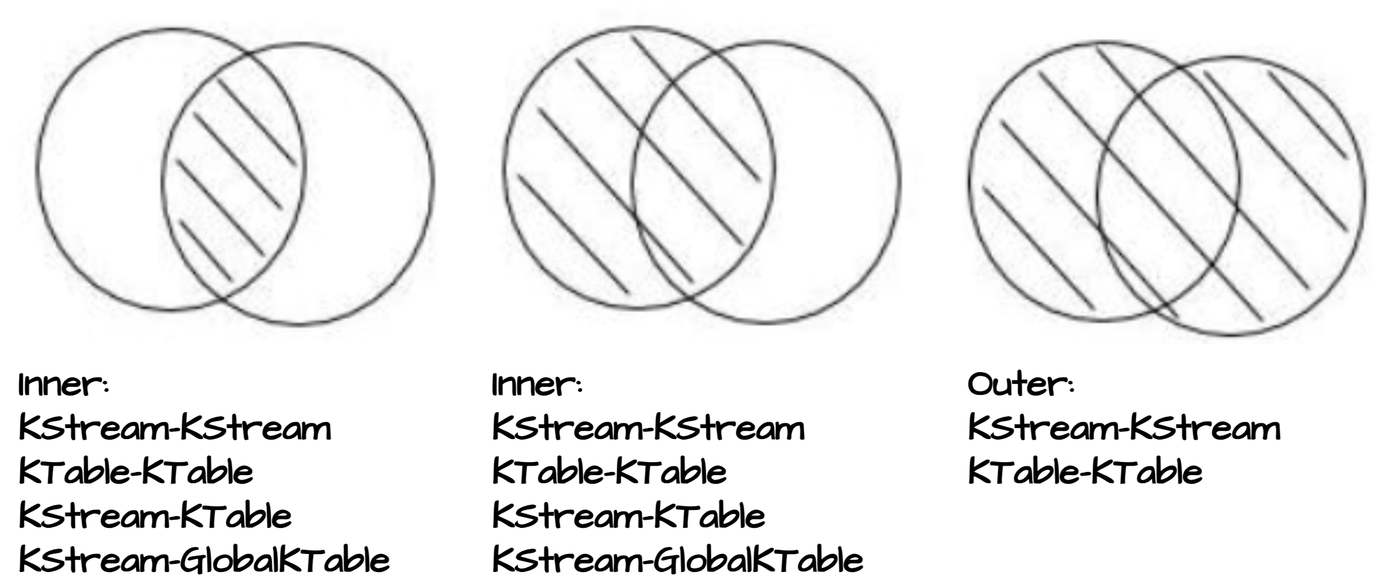
Joins
Its possible to join streams from multiple topics in Kafka. Three different types of joins are supported depending on the type of streams that you join:
Inner Joins: Emits an output when both input sources have records with the same key.
Left Joins: Emits an output for each record in the left or primary input source. If the other source does not have a value for a given key, it is set to null.
Outer Joins: Emits an output for each record in either input source. If only one source contains a key, the other is null.

Slide 22
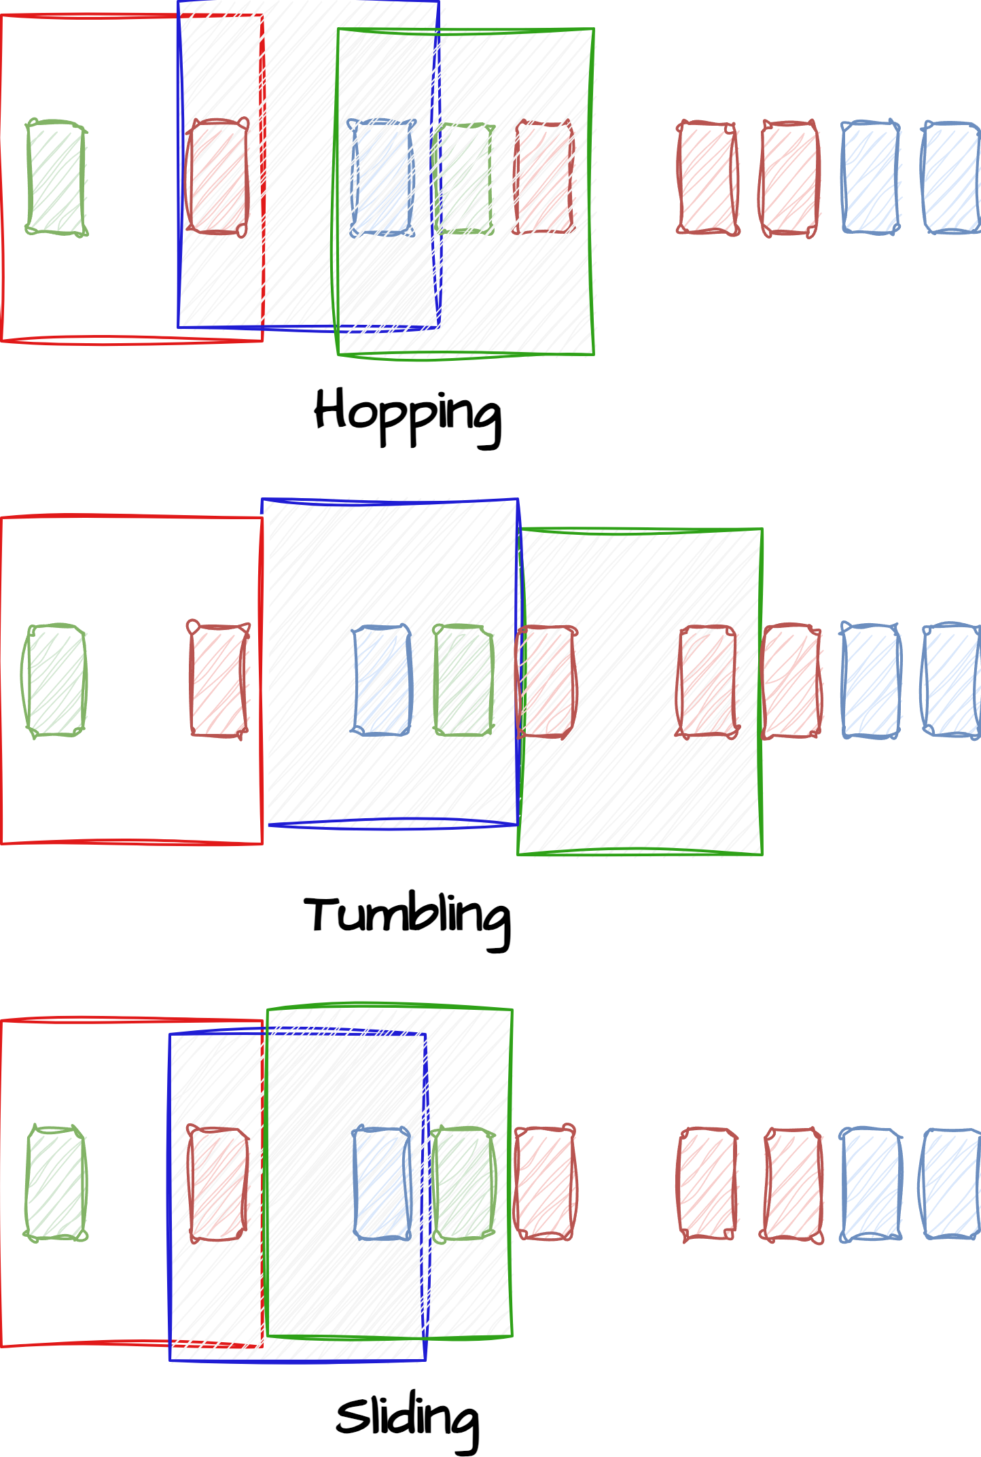
Windowing
When doing join operations on two infinite KStreams you need to narrow equality of keys based on a time window.
A windows is defined by a fixed width and an incremental factor (how it moves forward in time). If two events happens inside the same window they can be joined.
There are different definitions of time windows
Hopping, incremental step is fixed and less than the width of the window
Tumbling, incremental step is fixed and equal to the width of the window
Sliding, incremental step depends on the arrival of events

Slide 23
Join example
KStream<String, String> leftStream = builder.stream("topic-A");
KStream<String, String> rightStream = builder.stream("topic-B");
// ValueJoiner is applied whenever there is identical keys in both streams.
// Returns the result of the join operations
ValueJoiner<String, String, String> valueJoiner = (leftValue, rightValue) -> {
return leftValue + rightValue;
};
// Do the join between the two KStreams and narrow by a
// timewindow. A state store is created behind the scenes to handle
// the windowed state between the two streams
Kstream joinedStream<String, String> = leftStream.join(rightStream, valueJoiner, JoinWindows.of(Duration.ofSeconds(10)));
Define join operation

Slide 24
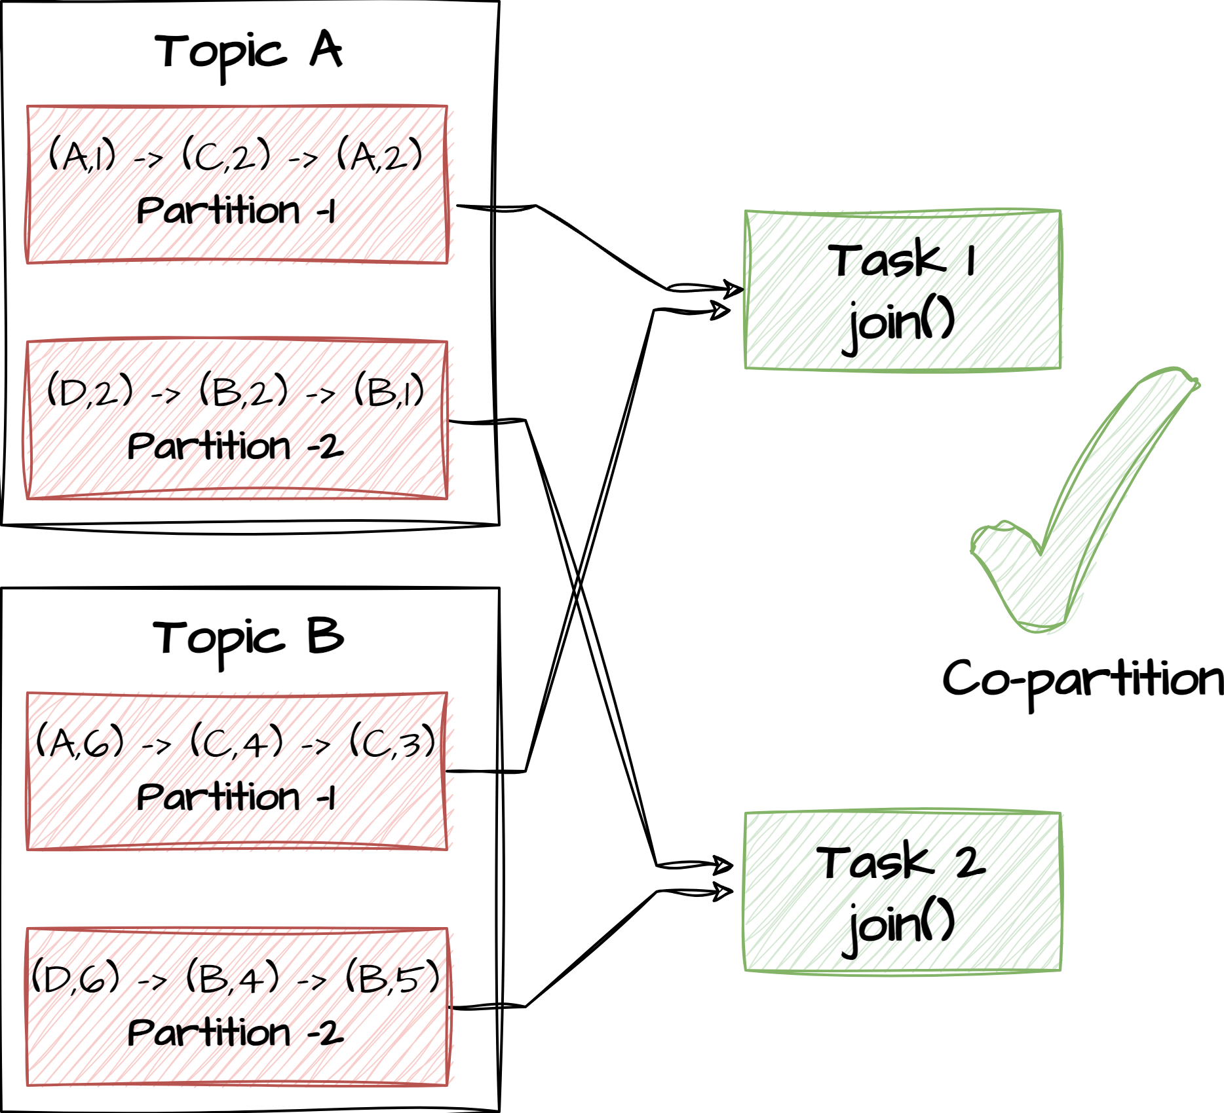
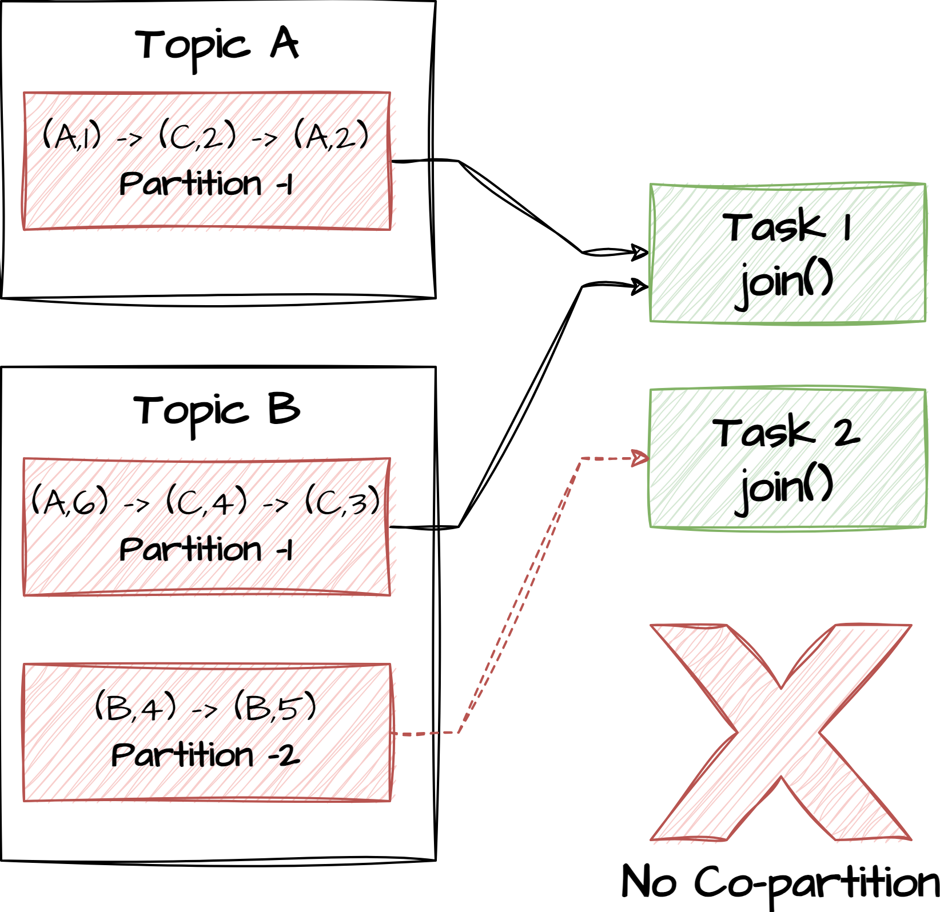
co-partition
Kafka stream joins work on key level. Keys that are identical can be joined.
When joining two KStreams, the two source topics must be co-partitioned, meaning that:
The keys must be semantically the same.
The topics must have the same number of partitions
The partition-algorithm must work the same way on the producer side.
This is important because otherwise the different tasks won’t get the right records

Slide 25
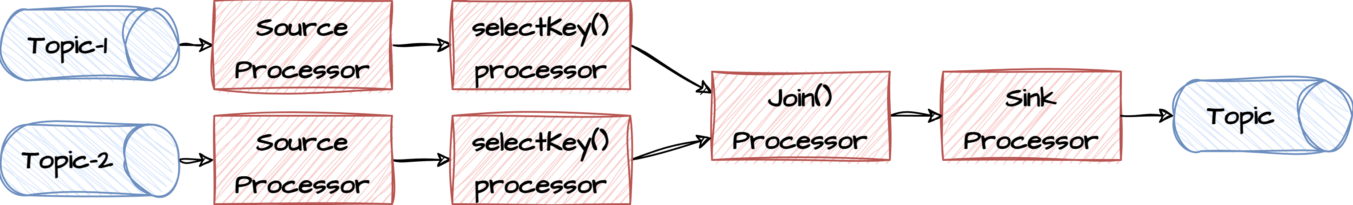
Exercise
Create joined streams
Create two input topics inputTopic-1 & inputTopic-2
Write a topology that read messages from the two topics, joins them (concat values) and write the output to an output topic. Use a timewindow of 10 seconds
Before joining the two streams make sure to re-key the streams to be able to join the streams. The key could be the first character in the message value
Start the stream application
Start a producer that produces messages to the input topic like this:
Open two PowerShell window and navigate to <project>/docker folder
Type .\kafka-producer-perf-test.bat --topic inputTopic-1 --num-records 10000 --throughput 1 --record-size 5 in one window
Type .\kafka-producer-perf-test.bat --topic inputTopic-2 --num-records 10000 --throughput 1 --record-size 5 in another window
Open a new powershell window and navigate to <project>/docker folder:
Type .\kafka-consumer.bat --topic outputTopic --from-beginning --property print.partition=true --property print.offset=true
Verify that a stream of joined streams is produced
8.5

Slide 26
Sub-topologies
Sub-topologies is a way of parallelizing your stream processing. Simply put the degree of parallelism depends on the number of tasks that can be run simultaneously which again depends on the number of partitions in the input topics. By breaking your topology into smaller chunks, you can increase the number of running tasks by introducing intermediate topics in the processing. This can be done explicitly using the repartition() operation or implicitly through re-keying the messages.
What about performance when re-partitioning?
new StreamsBuilder()
.stream("orders") // Create stream from topic
.flatMap(Ops::split)
.repartition() // write result to a topic and create a new stream from here
.filter(Ops::excludeArchivedValues)
.to("active-order-items"); // write result to topic

Slide 27
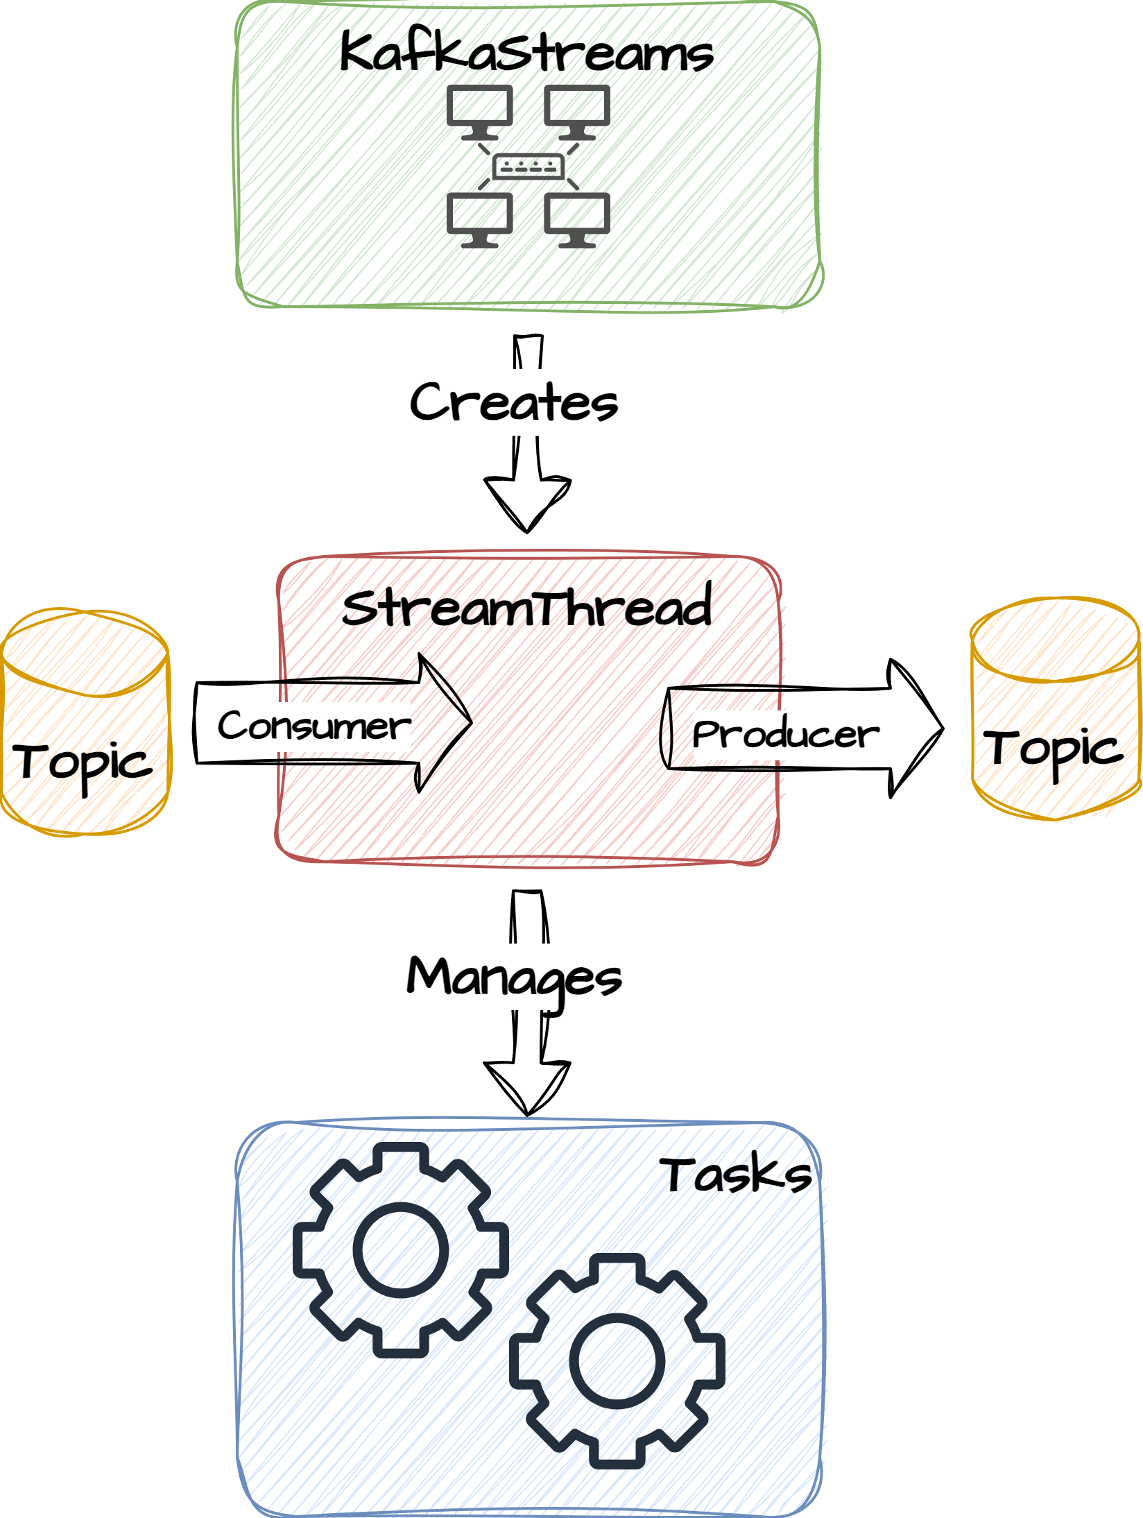
Construction the topologies
During startup of the KafkaStream instance these are roughly the steps that happen:
The Topology is built based on the DSL
A KafkaStreams instance is created using the specified configuration
KafkaStreams creates StreamsConfig.NUM_STREAM_THREADS_CONFIG instances of StreamThread. Each StreamThread has its own producer and consumer with the application.id used as the consumergroup.id
A StreamThread is a wrapper of 3 underlying threads. (Producer network thread, Coordinator heartbeat thread and the processor thread)
One or more tasks are assigned to each StreamThread
Using the StreamPartitionAssignor interface, one of the consumers is appointed the role of group leader. The leader ensures that partitions are evenly assigned among the different StreamThreads and that co-located partitions are processed by the same consumer
All StreamThreads are started when the KafkaStreams instance is started.

Slide 28
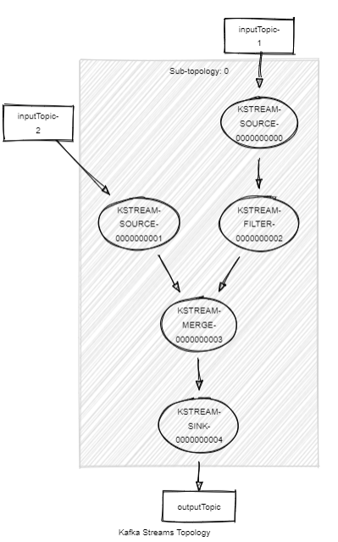
Visualize topology
When building the topology, you can get a description of how the internal topology is build by calling
Topology#describe(). Using this online tool https://zz85.github.io/kafka-streams-viz/ you can get a pretty visualization of the topology:
Try this
KStream<String, String> inputstream1 = builder.stream("inputTopic-1");
KStream<String, String> inputstream2 = builder.stream("inputTopic-2");
KStream mergedstream = inputstream1.filter((k, v) -> v.length() > 10).merge(inputstream2);
mergedstream.to("outputTopic", Produced.with(Serdes.String(), Serdes.Long()));
Topologies:
Sub-topology: 0
Source: KSTREAM-SOURCE-0000000000 (topics: [inputTopic-1])
--> KSTREAM-FILTER-0000000002
Processor: KSTREAM-FILTER-0000000002 (stores: [])
--> KSTREAM-MERGE-0000000003
<-- KSTREAM-SOURCE-0000000000
Source: KSTREAM-SOURCE-0000000001 (topics: [inputTopic-2])
--> KSTREAM-MERGE-0000000003
Processor: KSTREAM-MERGE-0000000003 (stores: [])
--> KSTREAM-SINK-0000000004
<-- KSTREAM-FILTER-0000000002, KSTREAM-SOURCE-0000000001
Sink: KSTREAM-SINK-0000000004 (topic: outputTopic)
<-- KSTREAM-MERGE-0000000003

Slide 29
Custom Processor
Its possible to specify custom processors and add them to the topology. This allows for more advanced processing if you have more complex business-logic that is incapsulated in its own components.
Context object provides access to topology
KStream<String, String> inputStream = builder.stream("inputTopic");
inputStream.process(MyProcessor::new).to("outputTopic);
public interface Processor<KIn, VIn, KOut, VOut> {
default void init(final ProcessorContext<KOut, VOut> context) {}
void process(Record<KIn, VIn> record);
default void close() {}
}
Add Processor
public class MyProcessor implements Processor<KIn, VIn, KOut, VOut> {
ProcessorContext<KOut, VOut> context;
void init(final ProcessorContext<KOut, VOut> context) {
this.context = context;
}
void process(Record<KIn, VIn> record) {
Record new_record = calcNewComplexRecord(record);
context.forward(new_record);
}
default void close() {}
}
Do complex stuff
Forward to next processor

Slide 30
Exercise / demo
Create custom processor
Create one input topics inputTopic
Write a topology that reads from the inputStream, holds back all records until a timer is triggered (3 sec interval) in a custom processor. Then concatenate all values and pass the new value downstream
Start the stream application
Open a PowerShell window and navigate to <project>/docker folder
Start a producer that produces messages to the input topic like this:
Type .\kafka-producer-perf-test.bat --topic inputTopic --num-records 1000 --throughput 10 --record-size 1 in one window
Open a new PowerShell window and navigate to <project>/docker folder:
Type .\kafka-consumer.bat --topic outputTopic
Verify that a stream of concatenated values are produced
8.6

Slide 31
Testing
public class SimpleStreamTopology {
public static Topology getTopology() {
StreamsBuilder builder = new StreamsBuilder();
var sourceStream = builder.stream(SimpleStreamConstants.SOURCE_TOPIC, ...);
sourceStream.filter((k, v) -> v%2 == 0)
.to(SimpleStreamConstants.FILTERED_TOPIC, ...);
return builder.build();
}
}
TestDriver to run the tests
public class SimpleStreamTopologyTest {
private TestInputTopic<String, Integer> inputTopic;
private TestOutputTopic<String, Integer> outputTopic;
@BeforeEach
public void init() {
Properties props = new Properties();
TopologyTestDriver testDriver = new TopologyTestDriver(SimpleStreamTopology.getTopology(), props);
inputTopic = testDriver.createInputTopic(SimpleStreamConstants.SOURCE_TOPIC,...);
outputTopic = testDriver.createOutputTopic(SimpleStreamConstants.FILTERED_TOPIC,...);
}
@Test
public void shouldFilterEvenvalues() {
for (int i = 0; i < 10; i++) inputTopic.pipeInput(““ + i, i);
var outputList = outputTopic.readValuesToList();
assertEquals(5, outputList.size());
}
}

